Slide 1


Securely bringing
to an embedded operating system
Samir Rashid

Slide 2


My background
Aviation software (C++/Python)
Operating systems (C/Rust)
Formal verification
Ethernet Router
Viasat: Networking Driver
Notes:
I worked on the path planning and flight software for this autonomous vertical takeoff plane.
Today I will show you some of the operating systems work I do
My research area is formal verification, which I will mention at the end.
Relating to this, I have worked on networking project which implements handling ARP, ICMP, and IP packets.
And I worked at Viasat on Linux networking drivers for a satellite modem.

Slide 3
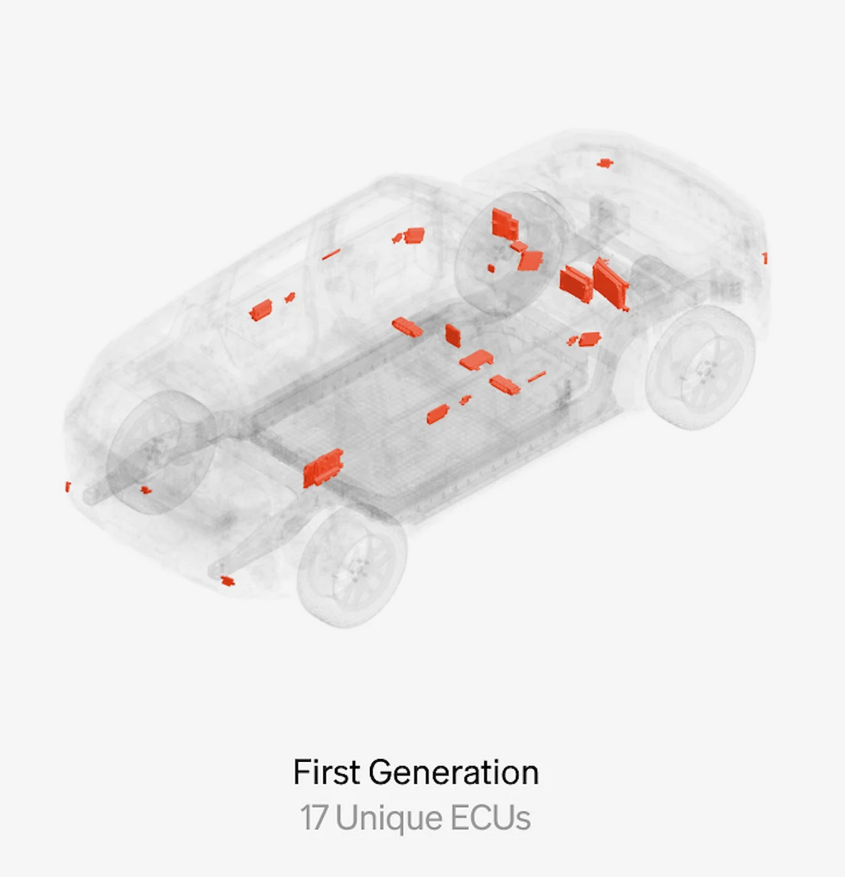
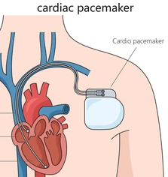
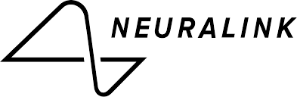
Motivation
Notes:
Embedded devices have become ubiquitous over my lifetime. These devices are getting more capable and more critical.
There is software **controlling your car, your heart, and your brain**. And these all have wireless access, and can be hacked.
WIRELESSLY AVAILABLE is a vast new attack surface
Users and developers demand more features from their devices. Traditionally, security is foregone on these low-power, resource-constrained embedded devices. With only a few kilobytes of memory to work with, the overhead of every security features becomes significant.

Slide 4
Embedded devices are ubiquitous and insecure.
Notes:
In other words, embedded devices are ubiquitous and insecure.
embedded devices do not have MMUs or hardware isolation.
what if we add a secure Thread networking stack to an embedded OS so device manufacturers can build off a secure base instead of using insecure libraries or reimplementing the stack

Slide 5
Embedded devices can be ubiquitous and secure.
Notes:
but we don’t need to throw our hands up in helplessness at the status quo.
Today I am presenting to you how we designed and deployed a production-grade networking stack on Tock OS.
I'll go over what the networking stack of choice is, Thread and why we chose it.

Slide 6
Outline
Background
1. What is Tock OS
2. What is Thread
A Deep Dive into bringing OpenThead to Tock
3. Architecture Design
4. Implementation Challenges

Slide 7
Outline
Background
1. What is Tock OS
2. What is Thread
A Deep Dive into bringing OpenThead to Tock
3. Architecture Design
4. Implementation Challenges

Slide 8






Embedded Operating Systems
Notes:
There are many OSes you may have heard of which target embedded systems

Slide 9



Embedded OS Characteristics
Kernel/Process Isolation
(configured by default)
General purpose operating systems (e.g. Linux):
Abstract and virtualize resources across processes.
Isolate a process’ memory r/w and faults to the given process.
Process/Process Isolation
Concurrent
Applications
Loadable
Applications
Fault Isolation
Tock allows the developer to write applications that are by default isolated, concurrent, and fault tolerant without modification to the kernel.
Notes:
whats common is all are virtualizing resources and share across many applications. multiprocessing. But all of them by default are basically operating as libraries and just give abstractions.
Tock is unique due to its uncompromising security.
The issue with them is that they sacrifice security in the name of performance and flexibility.
Tock is a secure OS which tries to show that you do not need to sacrifice any functionality to be secure. Tock isolates “processes” and the kernel, resembling the protection model of a desktop class OS.

Slide 10
What is Tock?
An embedded operating system designed for running multiple concurrent, mutually distrustful applications
on low-memory and low-power microcontrollers.
Notes:
Tock

Slide 11
TockOS
A preemptive embedded OS (runs on MCUs)
Cortex-M
RISC-V
Uses memory protection (MPU required)
Has separate kernel and user space
most embedded OS have the one piece software philosophy
Runs untrusted apps in user space
Apps written in C/C++ or Rust (any language that can be compiled)
Kernel (and drivers) written in Rust
Notes:
We have physical memory, no virtual memory. The MPU allows you to set bounds, architecture defined

Slide 12
Functional Components
Applications
User space processes
Any language
Independent executable
Capsules
Hardware independent drivers
Inside the kernel
Safe rust
HIL
Abstraction over hardware dependent drivers
Unsafe rust
System calls (syscall)
Hardware Interface Layer (HIL)
Notes:
Here is an overview. We can get into the kernel design if anyone has questions during or after the presentation. Otherwise I’m going to gloss over this as it is less relevant.
app load at runtiime, restartable, untrusted
capsules can be buggy but not malicious,

Slide 13





Used by
Notes:
these security properties are why it is used by these projects. Tock is in every recent Google Chromebook, Google Pixel, and in Microsoft Copilot+ PCs

Slide 14
Outline
Background
1. What is Tock OS
2. What is Thread

Slide 15
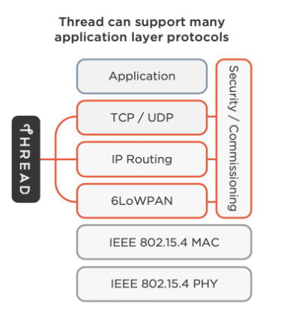
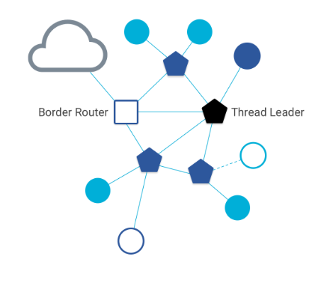
What is Thread
Thread builds a networking layer on top of IEEE 802.15.4.
Utilizes IPv6 routing for each node, allowing for interoperability with existing networks.
Combines star and mesh topologies to provide a robust network.
¹ Thread Group - Thread 1.3.0 Webinar; 9-29-22
Notes:
thread is created mainly for smart home and low power/ It

Slide 16

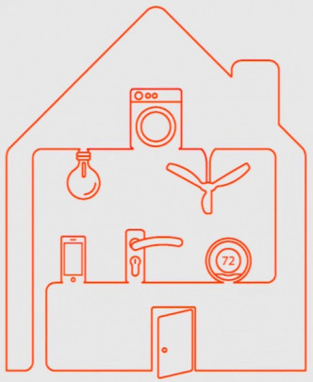
What is Thread?
Google Hub
fire alarm
nest thermostat
Border Router
Router Node
door lock
Child Node
door sensor
(Image of House) https://www.the-ambient.com

Slide 17
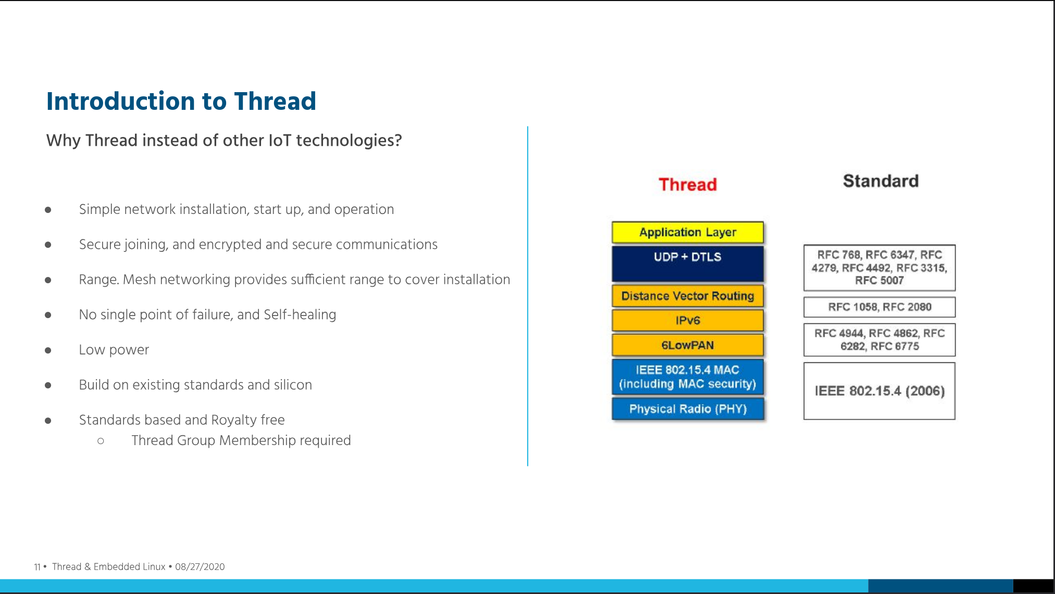
Notes:
https://lpc.events/event/7/contributions/795/attachments/677/1238/Using_the_Thread_Networking_Protocol_for_IoT_Applications_with_embedded_Linux.pdf

Slide 18
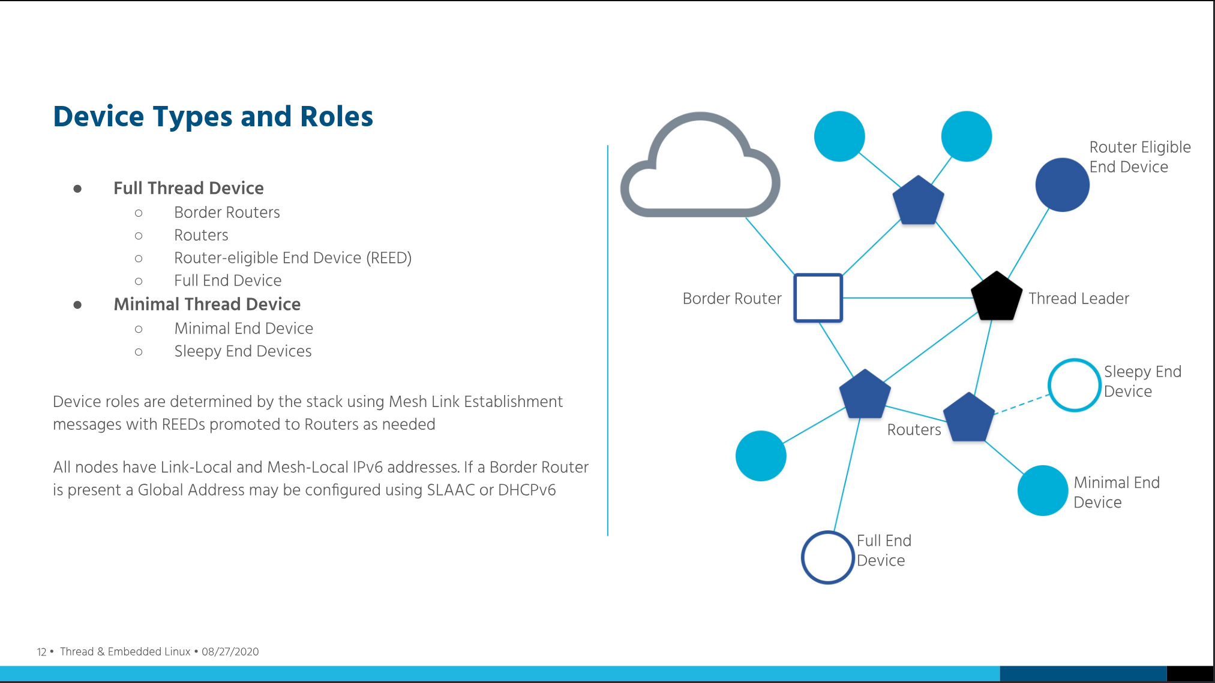
Notes:
https://lpc.events/event/7/contributions/795/attachments/677/1238/Using_the_Thread_Networking_Protocol_for_IoT_Applications_with_embedded_Linux.pdf

Slide 19
Outline
Background
1. What is Tock OS
2. What is Thread
A Deep Dive into bringing OpenThead to Tock
3. Architecture Design
4. Implementation Challenges

Slide 20
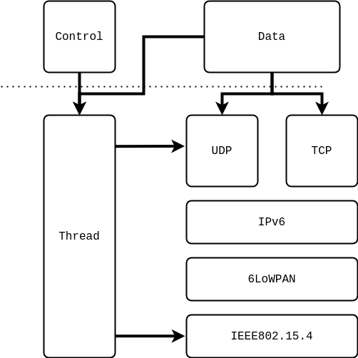
Naive Idea
App
Implement Thread in kernel
Issue:
Reimplement whole spec?!
Kernel Capsule
Notes:
This actually does exist as a proof of concept. But we were tasked with bringing this to production.
Minimal implementation.
Outcome
Successfully able to join an OpenThread network.
Engineering overhead for implementing entire Thread standard was substantial.

Slide 21

Tock and OpenThread
OpenThread: de facto open source Thread implementation that is actively maintained and contributed to.
Can we avoid reimplementing the Thread standard and instead just use this?

Slide 22
Tock and OpenThread Challenges
OpenThread is a large C library (foreign function interface with Rust kernel?).

Slide 23
Tock and OpenThread Challenges
OpenThread is a large C library (foreign function interface with Rust kernel?).
2. Tock’s threat model excludes the use of external dependencies.
Notes:
Tock faces a unique design challenge in supporting OpenThread as the Tock kernel's threat model explicitly bans external dependencies.
so if we are not going to reimplement thread, what can we do?

Slide 24
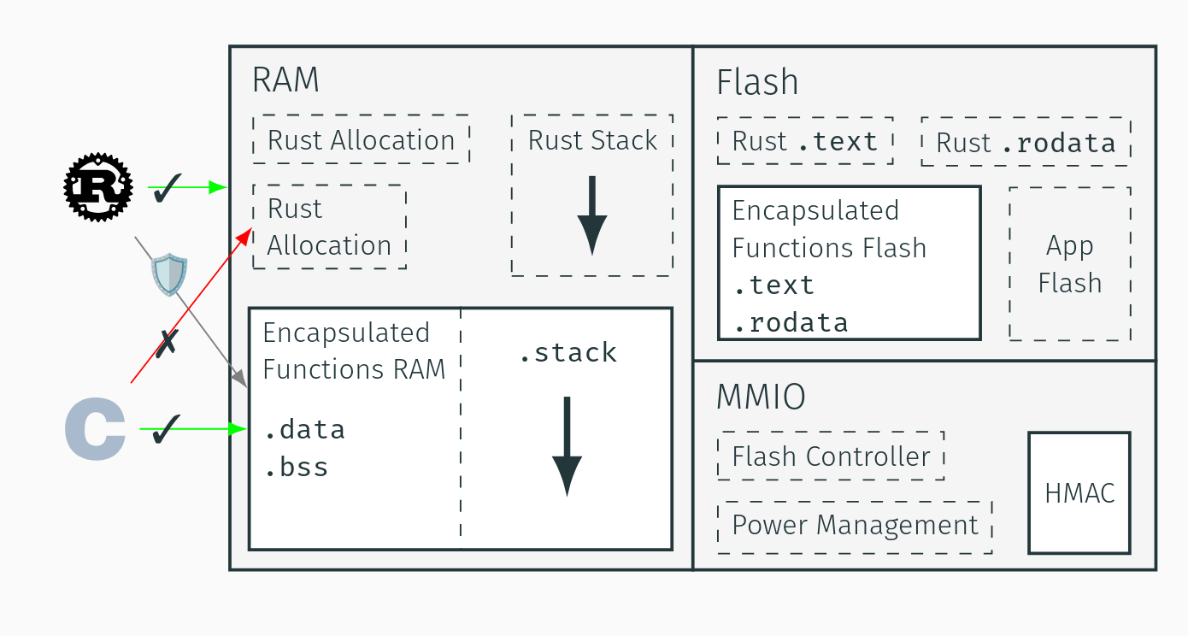
Idea: Hardware Isolate C/C++ in Kernel

Slide 25
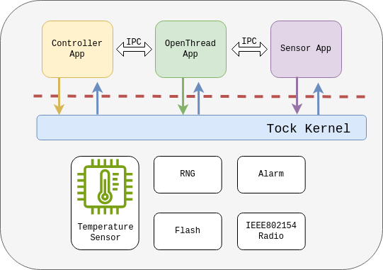
Tock and OpenThread
Run OpenThread as a userspace application.
OpenThread requires access to a radio, alarm, RNG, and flash
Applications use OpenThread via IPC
Notes:
if these two apps want to use thread, they do it via IPC rather than a syscall.

Slide 26
Tock and OpenThread Challenges
OpenThread is a large C library (foreign function interface with Rust kernel?).
2. Tock’s threat model excludes the use of external dependencies.

Slide 27
Tock and OpenThread Challenges
OpenThread is a large C library (foreign function interface with Rust kernel?).
2. Tock’s threat model excludes the use of external dependencies.

Slide 28
Tock and OpenThread Challenges
OpenThread is a large C library (foreign function interface with Rust kernel?).
2. Tock’s threat model excludes the use of external dependencies.

Slide 29
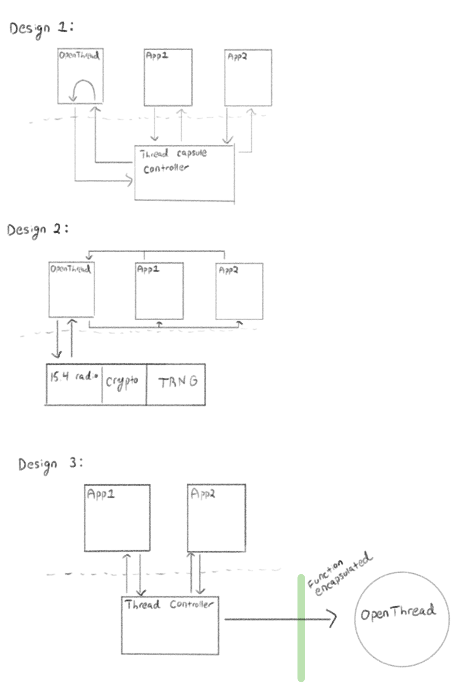
Tradeoffs
Rewrite it in Rust :)
bug prone
very inefficient to reimplement
Hardware isolated FFI (Encapsulated Functions)
experimental, risky as only shown for crypto
putting in kernel must be cooperative - cannot break isolation but bugs can hang kernel CPU or otherwise deadlock resources
Userspace (microkernel)
several ways to design the IPC interface, or to add a dummy driver which interfaces with the app, but ultimately each design is isomorphic
syscall and IPC overhead
no need to trust openthread code
Notes:
https://github.com/tock/tock/commit/3a11e2a6273c9c4d3a59db713257780380725d5f

Slide 30
Stakeholders
We knew there are three pillars we need to address and convince the maintainers we uphold:
Security
Performance
Efficient resource usage (flash)
Notes:
keep downstream users happy and maintainers will have to carry our code forever
Adding a Thread networking stack is an easy sell. Convincing the maintainers about our exact implementation is much more difficult.

Slide 31
Pause before we dive into code
We are going to start high level and go deep through
userspace ⟶ drivers ⟶ OS ⟶ architecture ⟶ registers

Slide 32
Outline
Background
1. What is Tock OS
2. What is Thread
A Deep Dive into bringing OpenThead to Tock
3. Architecture Design
4. Implementation Challenges

Slide 33
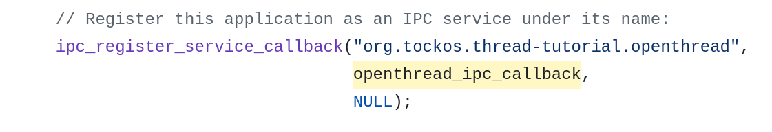
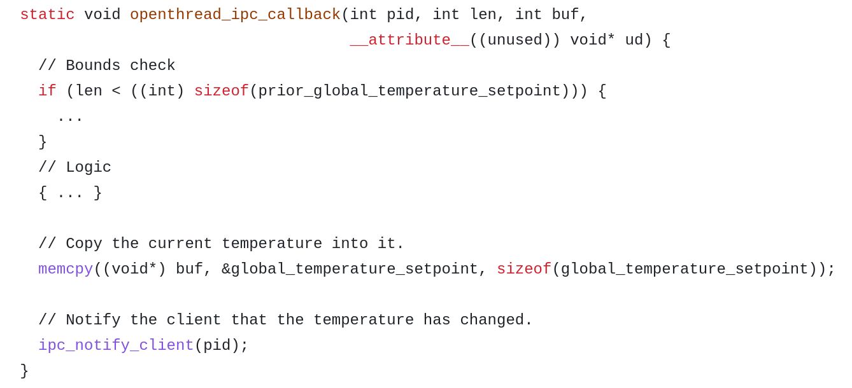
User Interface
OpenThread Process
Register IPC Service
IPC Callback
IPC
Payload
Payload
Payload
Payload
Notes:
we created an ipc wrapper for apps to use openthread
https://github.com/tock/libtock-c/blob/master/examples/tutorials/thread_network/12_openthread_ipc/main.c

Slide 34
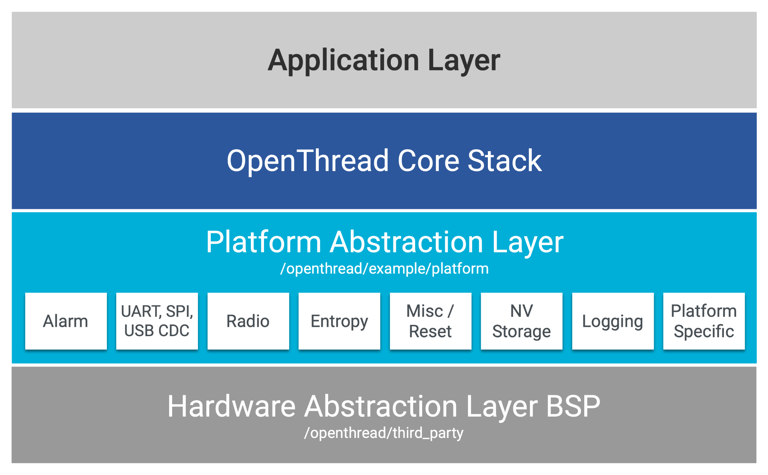
Platform files
Need to implement their headers
Go from high level function such as modifying radio state to the exact registers to write
Notes:
openthread is designed to be only thing running on board
need to implement pal, ipc interface, and virtualized pal like only have its own flash
https://github.com/openthread/openthread/blob/main/include/openthread/platform/radio.h
example platform file
only one implementation….
Spec ==== the implementation?
Need to debug OpenThread

Slide 35
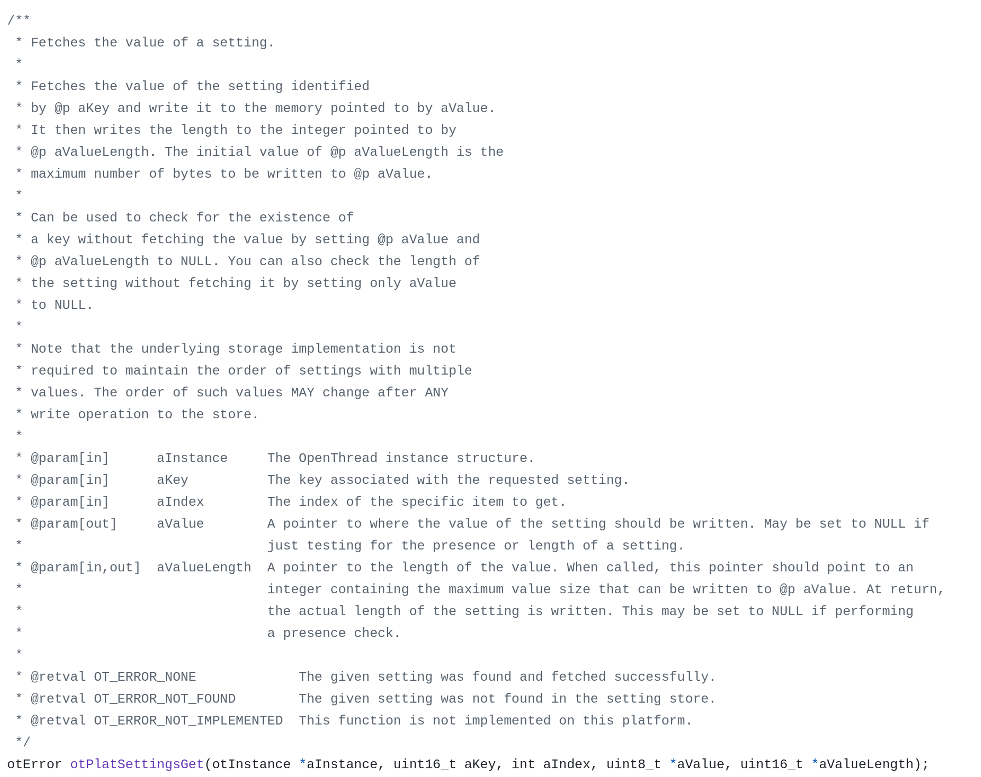
Example
Notes:
informal spec to implementation. requires understanding Thread spec at times.
Spec ==== the implementation?

Slide 36
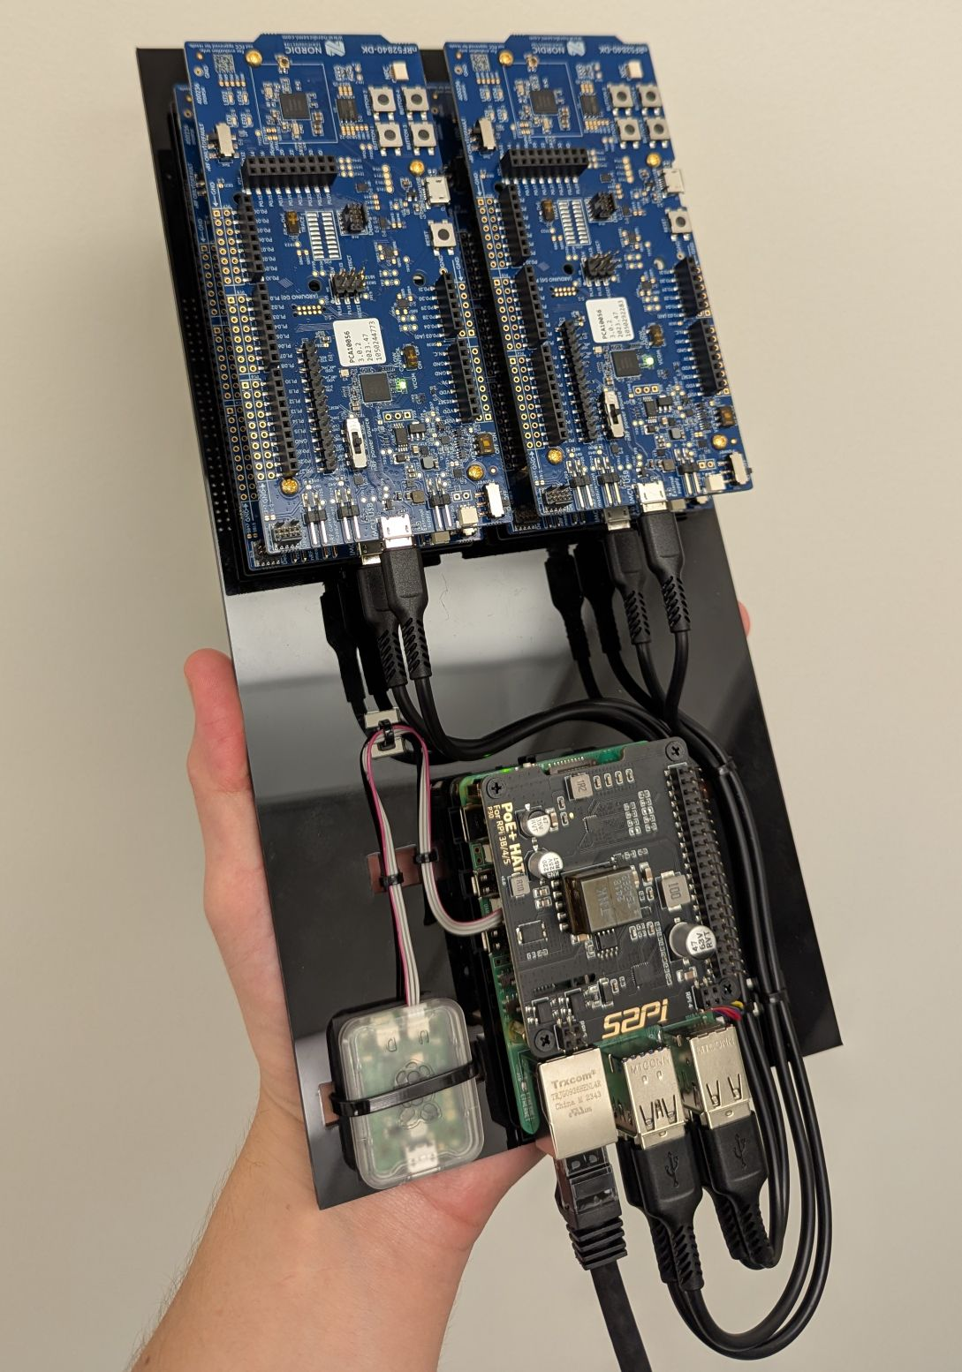
It works…?
Test joining mesh net with reference implementation
misbehavior after a few minutes of testing
Notes:
These require a lot of normal implementation work, dealing with build systems, reading specs and OpenThread source code,
after debugging all imediate crashes, there were some other
issues
crash at 30 sec due to 24 bit overflow (what is prescaler, precision and energy tradeoff, interrupt at wrong time)
crash at 7 min due to 32 bit overflow (incorrect library wrapper fn used, no millisec API offered)
crash at [7min, inf) by bounding error manually
no crashes ever by formal verification

Slide 37
Timer architecture diagram, layers
Notes:
virtualization layers

Slide 38
crashes, timer?
crash at 30 sec due to 24 bit overflow (what is prescaler, precision and energy tradeoff, interrupt at wrong time)
crash at 7 min due to 32 bit overflow (incorrect)
crash at [7min, inf) by bounding error manually
no crashes ever by formal verification
Notes:
These require a lot of normal implementation work, dealing with build systems, reading specs and OpenThread source code,
as the OS we are abstracting away a single physical timer and abstracting its constraints such as oscillator frequency or register width behind the syscall API.

Slide 39
Bug 1
crash at 30 sec due to 24 bit overflow (what is prescaler, precision and energy tradeoff, interrupt at wrong time)
Notes:
These require a lot of normal implementation work, dealing with build systems, reading specs and OpenThread source code,
as the OS we are abstracting away a single physical timer and abstracting its constraints such as oscillator frequency or register width behind the syscall API.

Slide 40
Github issues
The client should not assume anything about the underlying clock used by an implementation other than that it is running at sufficient frequency to deliver at least millisecond granularity and that it is a 32-bit clock (i.e. it will wrap at 2^32 clock ticks).
31 23 0
overflows early!
Notes:
interrupt is too early as timer isn’t wide enough
https://github.com/tock/tock/pull/3973
https://github.com/tock/tock/pull/3975

Slide 41
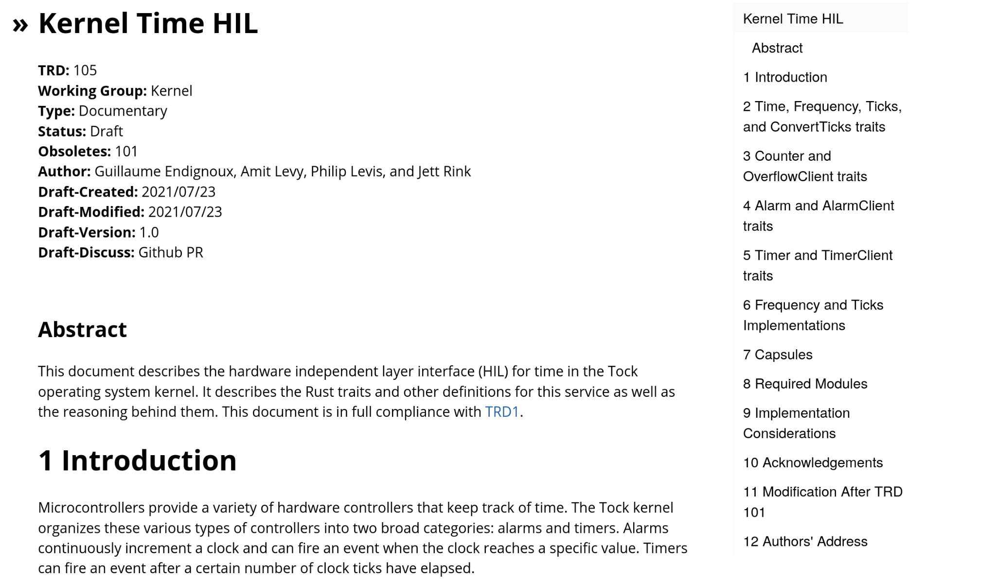
Kernel hack fix
Must conform to the kernel ABI
timers haven’t changed since v1
Must be
hardware agnostic
architecture agnostic
no regressions in user programs
Notes:
These require a lot of normal implementation work, dealing with build systems, reading specs and OpenThread source code,
How to deal with wrapping without changing ABI?
In this release, we revised Tock's alarm system call driver implementation to predictably wrap its ticks values at (2**32 - 1) ticks, across all platforms. Before this change, hardware alarm implementations that were less than 32 bit wide would wrap before reaching (2**32 - 1) ticks, which complicated correct alarm handling in userspace. In Tock 2.2, these alarm implementations are scaled to 32 bit, while also scaling their advertised frequency appropriately. While this change is non-breaking and compatible with the previous alarm implementation, it can expose such scaled alarms to userspace at significantly higher advertised frequency values. Userspace alarm implementations that did not correctly handle such high frequencies may need to be fixed to support this new driver implementation.

Slide 42
Bug 2
crash at 7 min due to 32 bit overflow (incorrect)
Notes:
These require a lot of normal implementation work, dealing with build systems, reading specs and OpenThread source code,
as the OS we are abstracting away a single physical timer and abstracting its constraints such as oscillator frequency or register width behind the syscall API.
https://github.com/tock/libtock-c/pull/395

Slide 43
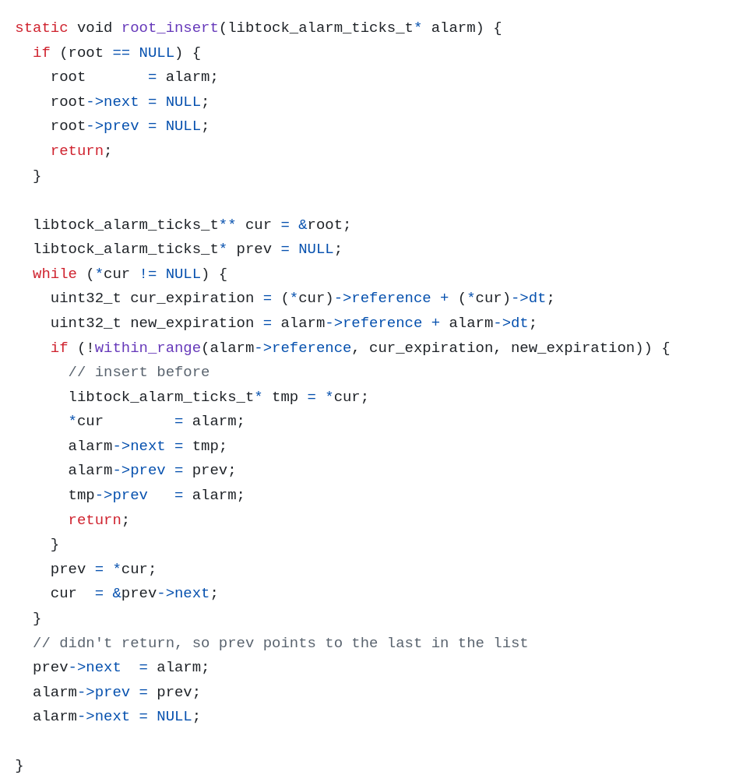
Timers work by virtualizing a linked list
10 -> 11 -> 1000 ->

Slide 44
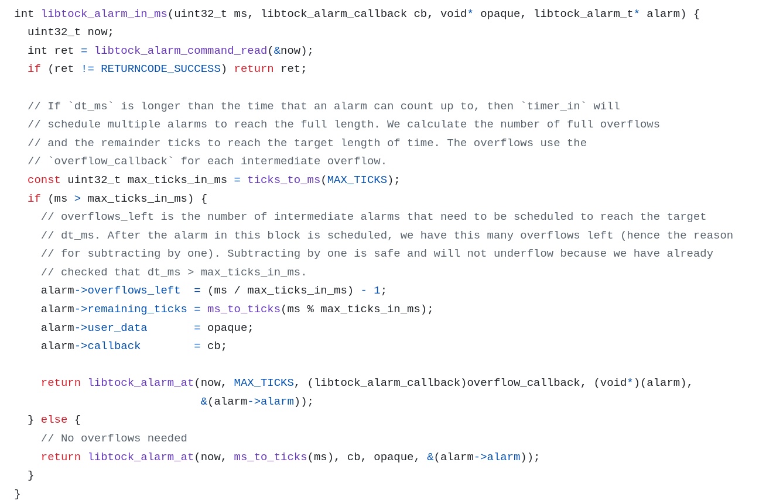
2 cases

Slide 45
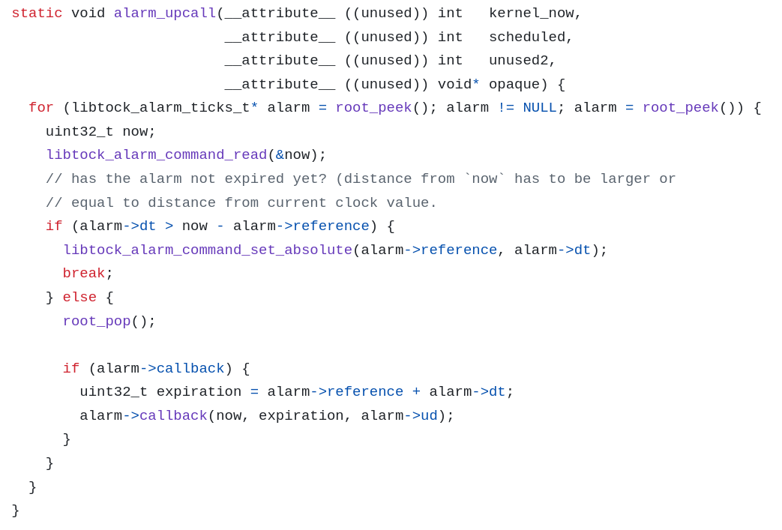
timer interrupt

Slide 46
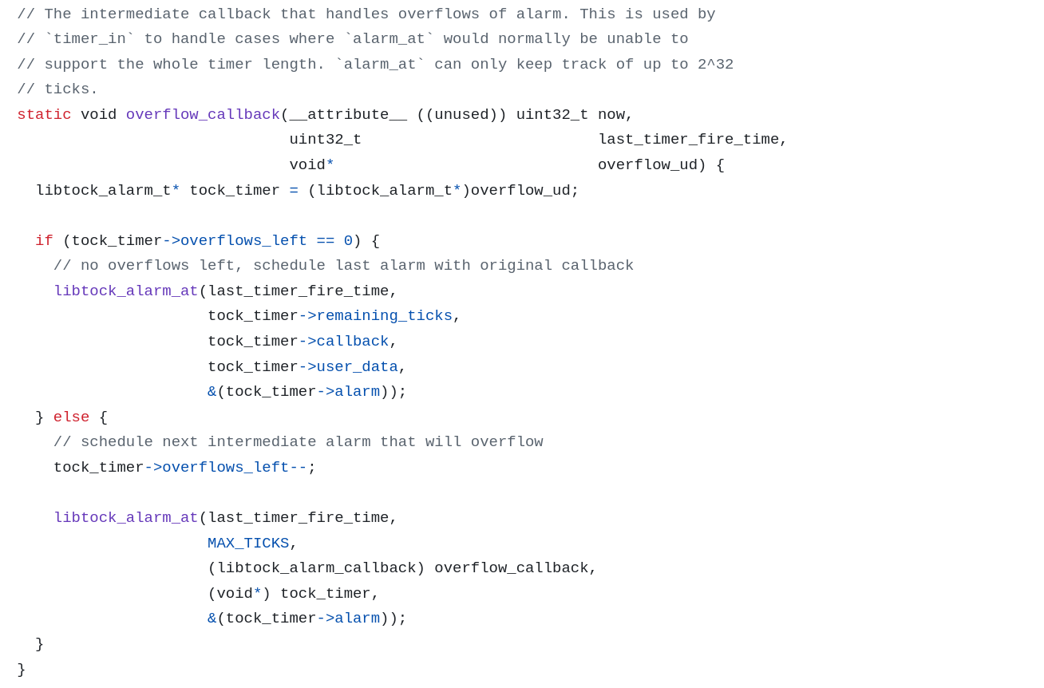
on overflow

Slide 47
Bug 3
crash at [7min, inf) by bounding error provably
Notes:
These require a lot of normal implementation work, dealing with build systems, reading specs and OpenThread source code,
as the OS we are abstracting away a single physical timer and abstracting its constraints such as oscillator frequency or register width behind the syscall API.

Slide 48
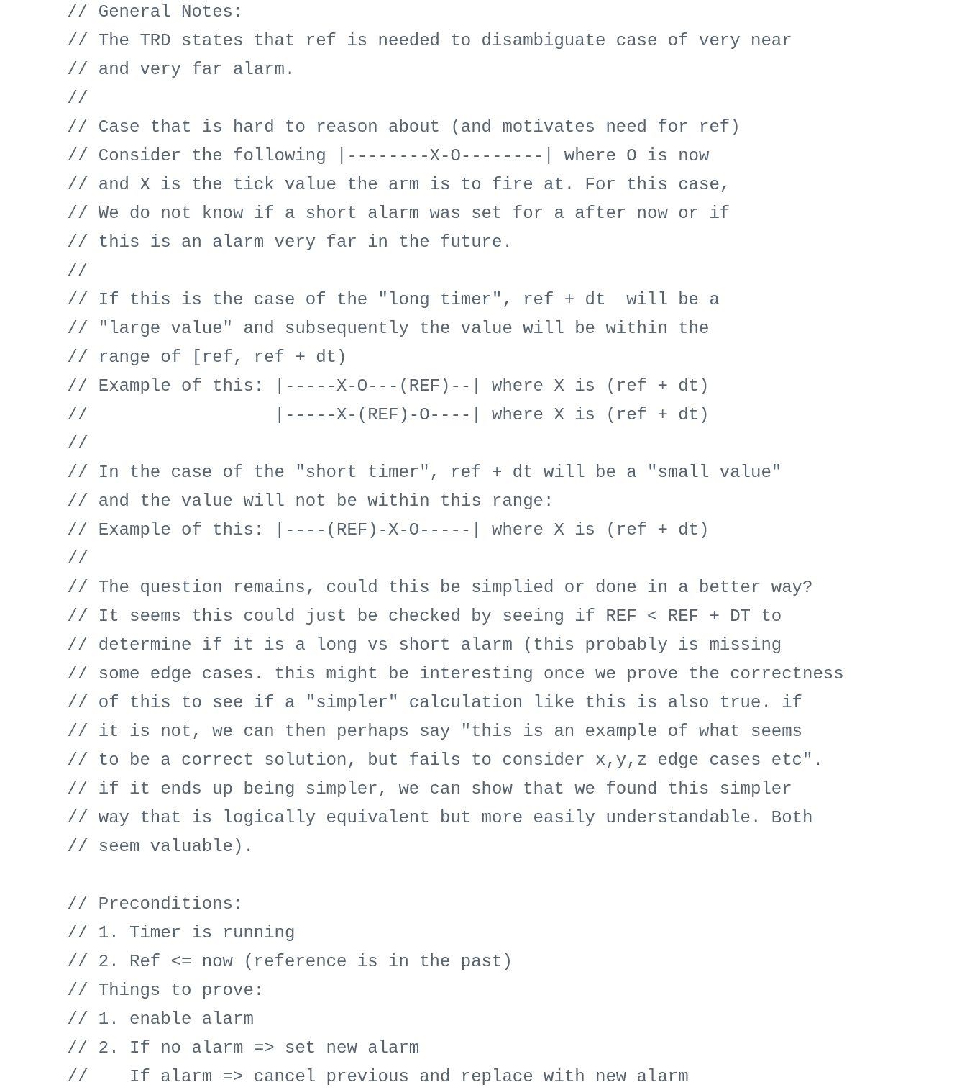
Correctness is hard!
Lots of informal specification in comments
Deal with interleaved execution, race conditions, data structure corruption, worst case execution bounding
Notes:
https://github.com/emugnier/tock/commit/3508f3fddb06bfb52b6a424bb1ba3cb5bc3a9047 https://github.com/emugnier/tock/blob/334bbc5eb44d89671731e48cc763935fcc3adf21/chips/nrf5x/src/timer.rs#L330
This comment is justifying an edge case in one argument of one function.

Slide 49
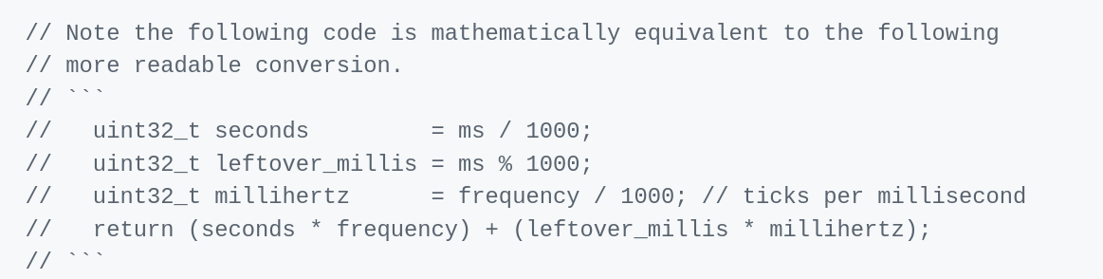
Proved upper bound of timer error

Slide 50
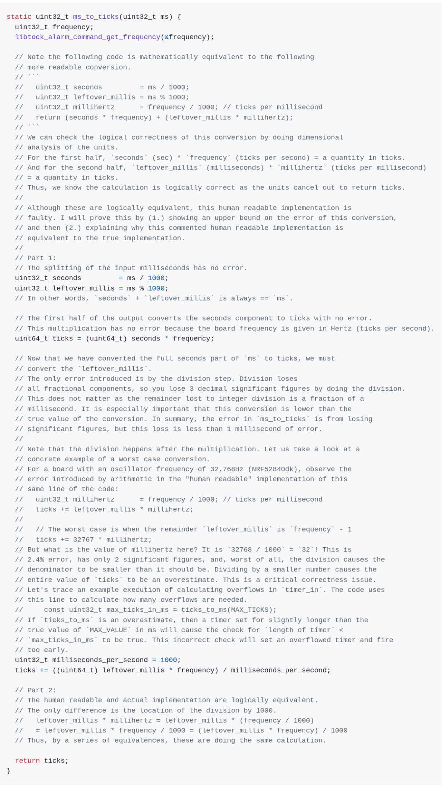
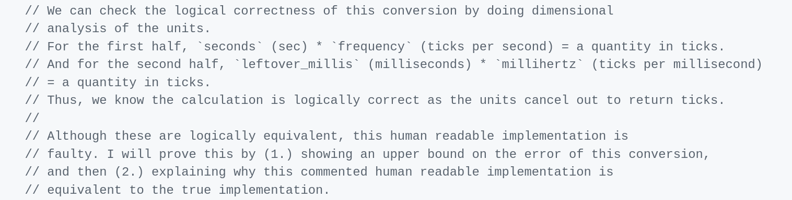
Math proof

Slide 51
4 TIMER_WIDTH_TICKS + Δ
incorrect logic:
num_overflows = length_ms / overflow_ms;

Slide 52
4 TIMER_WIDTH_TICKS + Δ
incorrect logic:
num_overflows = length_ms / overflow_ms;

Slide 53
Bug 4 onwards
Master’s thesis:
Working on automated proof of the timer code to a formal model

Slide 54
Recap
Userspace timer virtualization, millisecond api, bound error
> virtualized resources in PAL
Driver API changes (not described),
virtualizes app timers (not described)
Kernel hide timer width
Register use prescaler hack (not described)
Result: it works! Taught a class using Thread.
Notes:
need to implement pal, ipc interface, and virtualized pal like only have its own flash

Slide 55
This Work - Tock and Wireless Networking
Bridging Tock’s default isolation and robustness to provide a by default secure, robust, and updatable IoT/wireless sensor network platform.
Notes:
medical device grade security

Slide 56
Q&A
We ported a Thread networking stack to Tock OS without
introducing any dependencies or changing the threat model.
Required making
(virtualized) PAL
writing an IPC interface
fixing and adding features to Tock
debugging the Thread spec and OpenThread implementation
dealing with bugs reaching all the way into the hardware manual

Slide 57
References
Userspace Thread source tree
TRD105: Time - The Tock Book Time ABI specification
Communications App - The Tock Book
IPC - The Tock Book
IPC Tutorial - Tock Book
OSFC Tock OS verification
https://github.com/orgs/openthread/discussions/9872 ask maintainers
OpenThread Tutorial IPC Code
Original Networking wg Thread porting planning documentation

Slide 58
Done in half the time?
constraints mean the project could not have been done faster
We are not the judges - it is the maintainers. So to upstream, they must be satisfied. Ultimately, they will maintain the code forever.
The solution must be the best solution on
Security
Performance
Efficient resource usage (flash, like how timers are)
OR justify and prove that it is good enough

Slide 59
Half the time
Security
Make its process privileged or run in kernel
can arbitrarily corrupt Rust kernel guarantees
Nordic Semi supports bare metal, so we can just steal their implementations and allow OpenThread to write to registers instead of going through kernel APIs
compromised security options already exist

Slide 60
Backup Slides

Slide 61
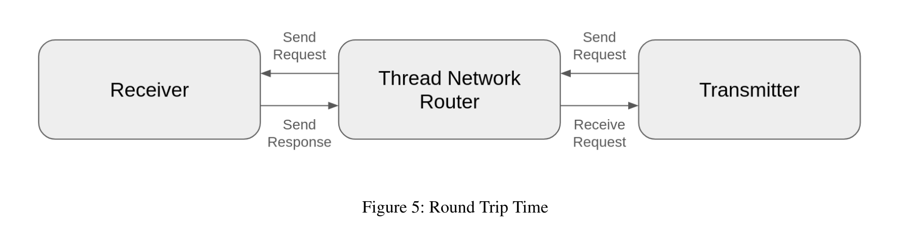
Profiling overhead
Notes:
I wrote very good benchmarks

Slide 62
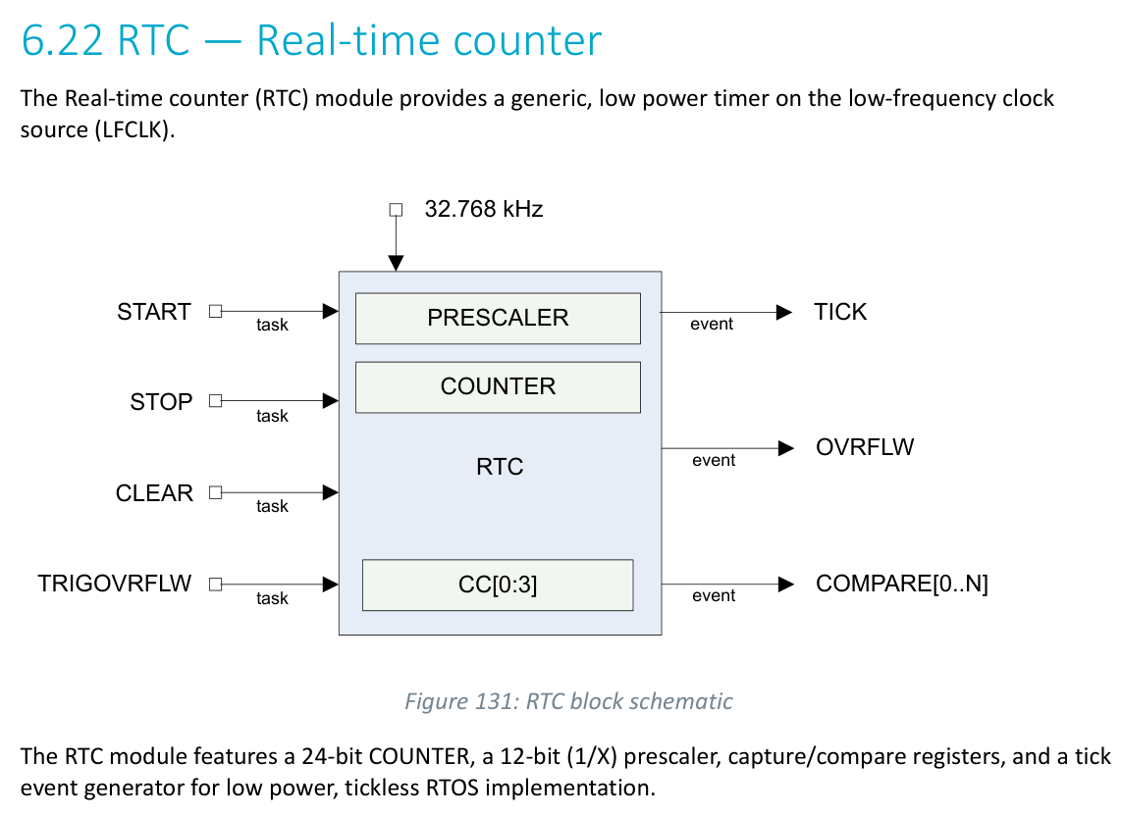
Github issues
Proposal 1:
I propose we concatenate the prescaler and alarm buffers.
Denied as it isn’t general to boards which actually do not have 32 bit timers. These are common on low power boards.
Notes:
https://github.com/tock/tock/pull/3973#pullrequestreview-2032887063

Slide 63
Tock architecture slides
https://godsped.com/files/osfc24/slides.html?f=5#11

Slide 64
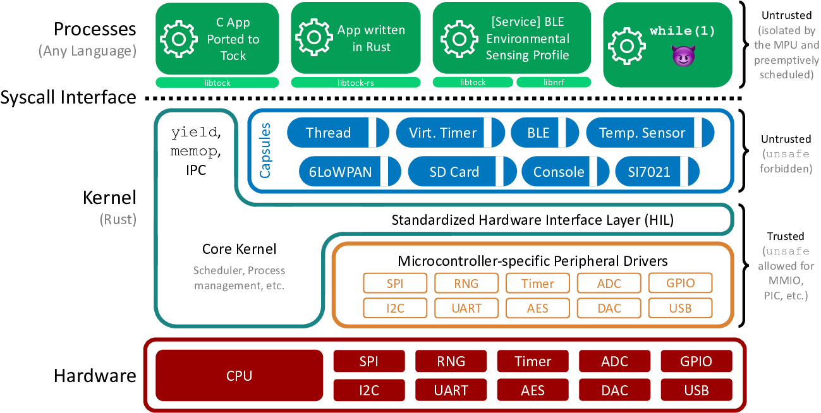
Architecture
Notes:
Image from https://github.com/tock/tock/blob/master/doc/Overview.md
I am going to skip some slides about the OS and we can come back to them if there are questions.
here is another diagram showing the same thing

Slide 65
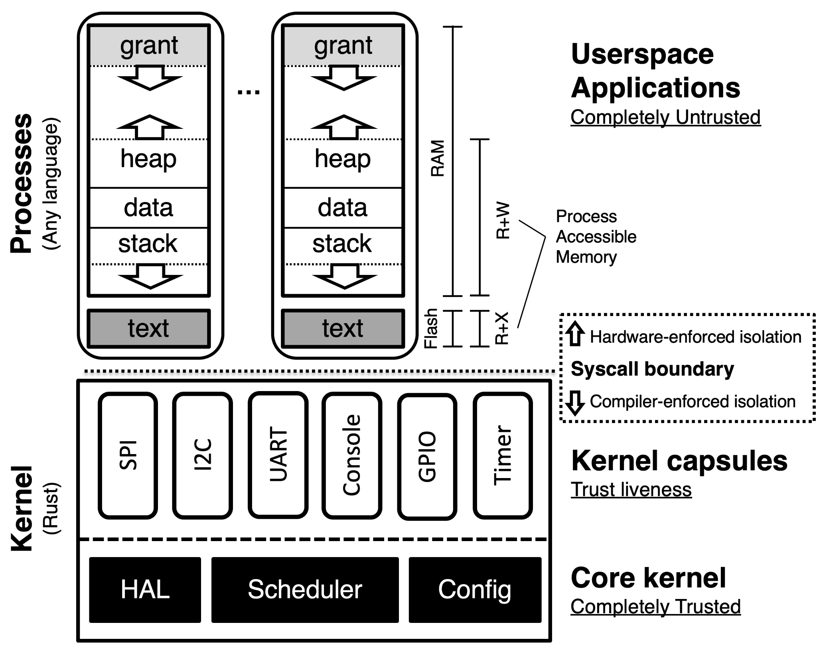
Kernel
Non preemptive
Capsules (drivers) run to completion
Asynchronous API
Does not allocate dynamic memory
Only static buffers
No out of memory errors in kernel
Grants
Memory for capsules in user processes
Allocated at the start of a process (if possible)

Slide 66
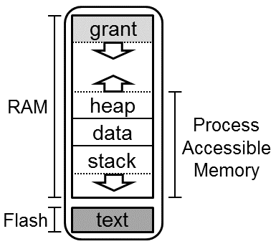
Application (Process)
Standalone executable
compiled without TockOS kernel
Memory Protection
MPU Regions
Can (seg)fault
Relocatable code
if supported by the compiler
IPC
service discovery
Preemptible by the kernel

Slide 67
Grant Region
Microcontrollers are severely memory constrained.
Dynamic memory in the kernel has the potential to crash the kernel if memory is exhausted.
Grants are Tock’s solution to this issue:
Static memory used in kernel.
Kernel can dynamically allocate memory in the application’s grant as needed.
Key Takeaway: Grant memory exhaustion will only fault process, not the kernel.

Slide 68
Userland libraries
Libtock-C
Libtock-RS
Stable (recommended)
newlib
libc
libm
libc+
Lua53
LittlevGL
RV32: no suitable PIC support (as of May 2024)
not stable yet
core
active development
No suitable PIC support in LLVM (as of May 2024)

Slide 69

Tockloader
Manage Tock OS Application
Uses TAB files
Written in Python
Built-in support for several boards
Small App Store

Slide 70
Encapsulated Functions
Another nice approach

Slide 71
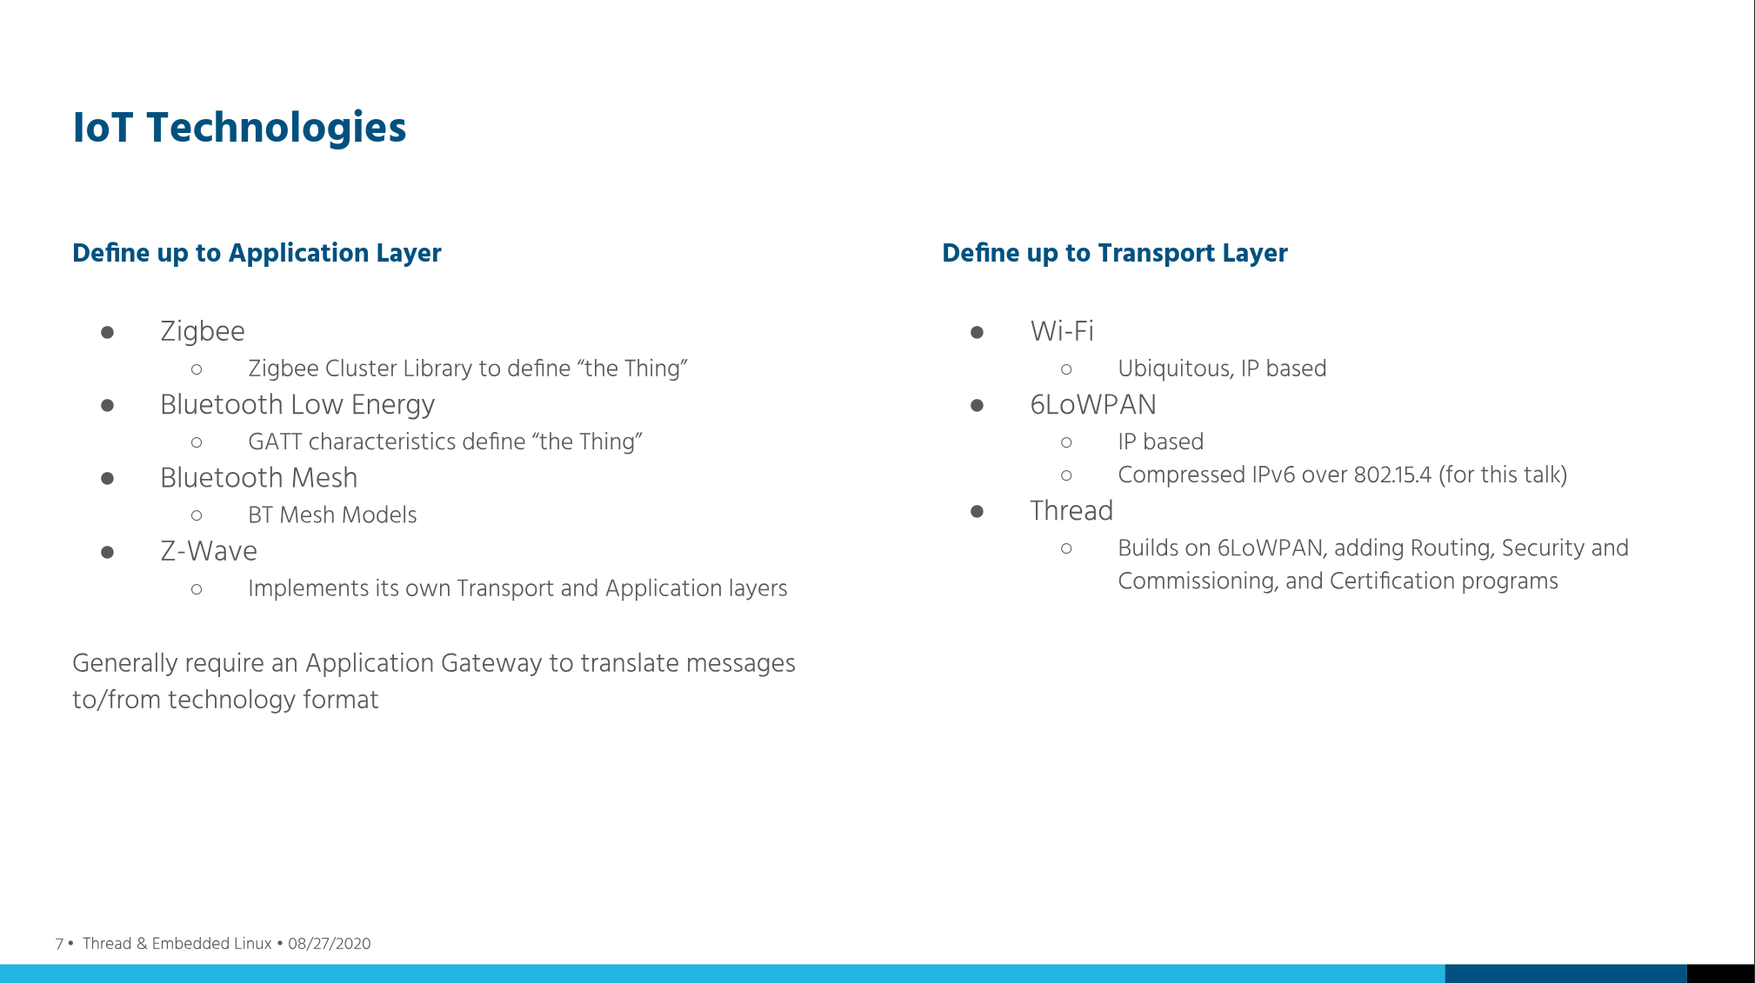
Notes:
comparison of iot wireless options
https://lpc.events/event/7/contributions/795/attachments/677/1238/Using_the_Thread_Networking_Protocol_for_IoT_Applications_with_embedded_Linux.pdf

Slide 72
